Slide 1
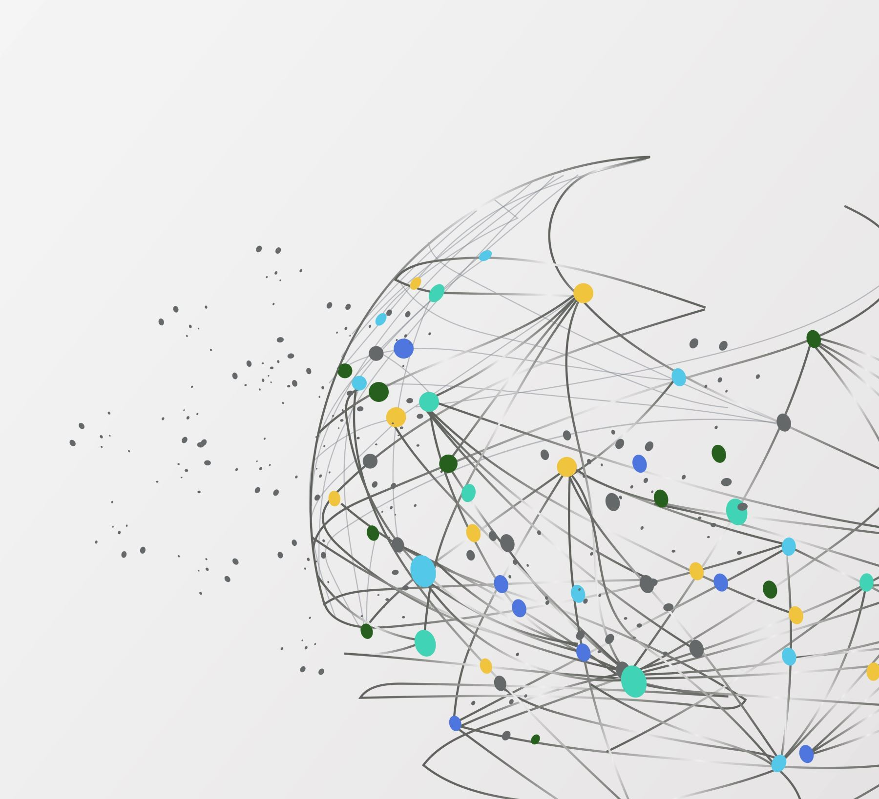
NVIDIA GPU-based basic training for Deep Leaning
Dr. Venkataramana Veeramsetty
Professor in School of CS & AI
SR University, Warangal

Slide 2
What is a CPU?
CPU is Central Processing Unit which is optimized for General-purpose computation and Sequential processing
It has capability of fast switching between the tasks. It has few powerful cores (4-16)
It has large cache memory and low-latency tasks
It is best for single-threaded tasks, complex logic and general purpose allocations

Slide 3
What is gpu?
GPU is Graphics Processing Unit is optimized for: Parallel computation, Processing large amounts of data at once and Matrix operations (ideal for deep learning)
GPU architecture has thousands of smaller but efficient cores like NVIDIA RTX 4090 has 16,384 CUDA cores
GPU is best for Matrix multiplication, Vector operations, Deep learning, Image processing and Scientific simulations

Slide 4
Why Deep Learning Needs GPUs
Deep learning requires:
  Millions of parameters
  Huge matrix multiplications
  Convolutions
  Gradient computations
These operations run massively parallel, so GPUs give 10× to 100× speedup.

Slide 5
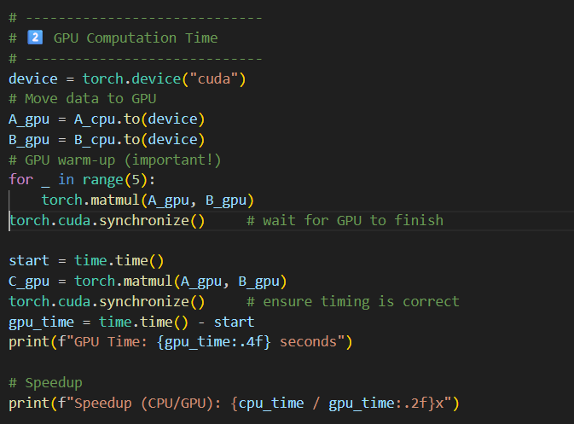
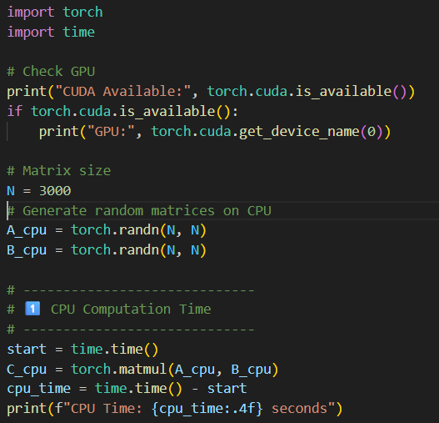
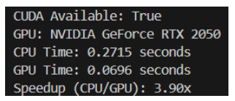
CPU Vs. GPU

Slide 6
When to Use CPU vs GPU?
Use CPU when:
Running OS-level programs
Light workloads
Decision-oriented logic
Small ML models
Model inference on small inputs
Use GPU when:
Training deep learning models
Processing large datasets
Performing matrix-heavy operations
Running computer vision models
Doing parallel simulations

Slide 7
Analogy for Students
CPU = A single teacher explaining topics one-by-one
️GPU = A classroom of 10,000 students solving 10,000 math problems simultaneously
GPUs accelerate tasks with parallel processing

Slide 8
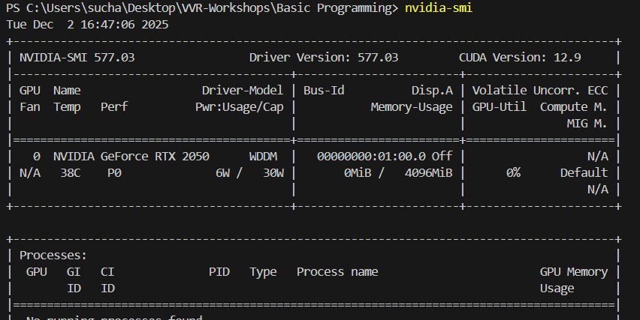
SETUP
NVIDIA GPU Driver : nvidia-smi
PyTorch with CUDA: pip install torch torchvision torchaudio --index-url https://download.pytorch.org/whl/cu121

Slide 9

Thank You

